Slide 1

Coachella
Sphere of Influence
march 17, 2025

Slide 2
UPDATES
City Update
LAFCO Application Update
City Utilities
Questions

Slide 3
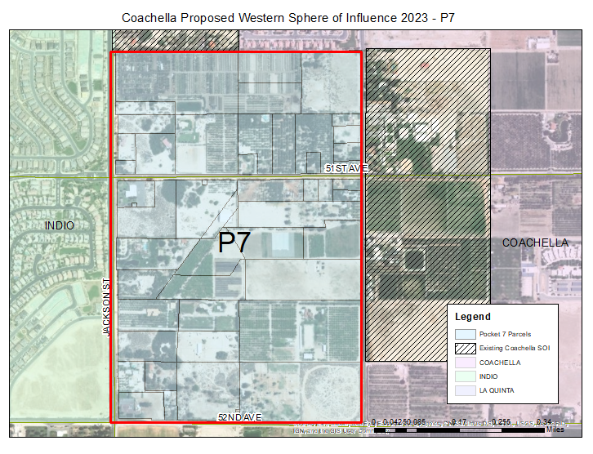

Slide 4
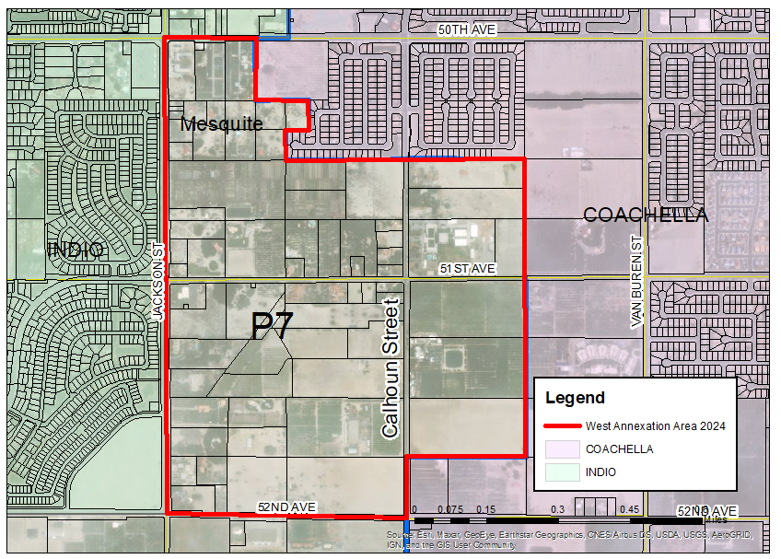

Slide 5
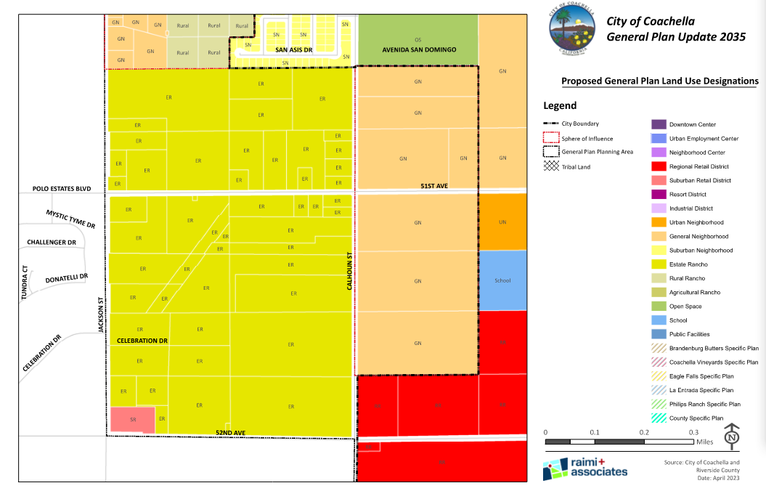
Estate Rancho
1.0-2.2 du/acre
Suburban Retail

Slide 6
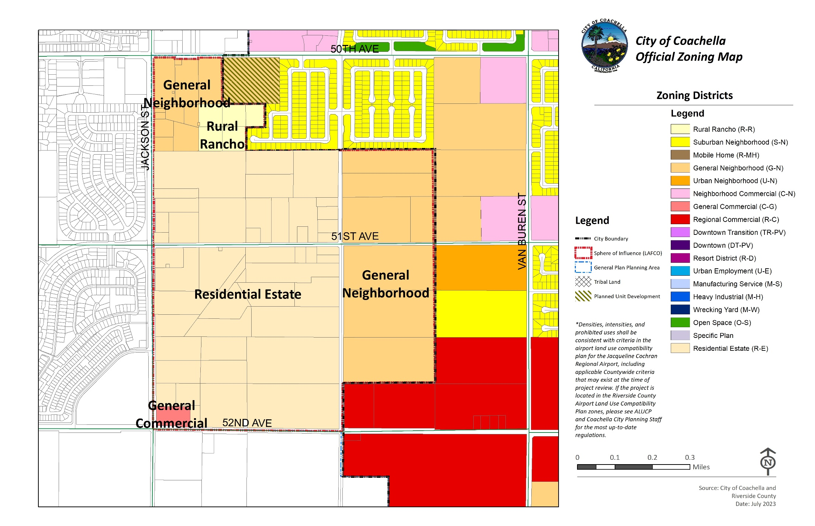
Prezoning

Slide 7
Residential Estate Zone
Minimum 20,000 sq. ft. lots
Primary Uses
  Dwellings, single-family detached. No more than one such dwelling shall be permitted on one lot regardless of the size of the lot.
  Public and private parks.

Slide 8
Residential Estate Zone
Accessory Uses:
  Keeping of Horses
  Parking Facilities
  Pens and other shelter for domestic, noncommercial animals and pets.
  Field crops, trees, vegetables, fruits, berries and nursery stock, including wholesaling of crops produced upon the premises.
  Restaurant as an accessory use associated with growing of field crops, trees, vegetables, fruits, berries and farm stands.

Slide 9
Residential Estate Zone
Conditional Uses:
  Clubs and lodges, private, nonprofit when site fronting on an arterial street.
  Public and private golf courses.
  School, private, nonprofit.
  Farm stands.
  Bed and Breakfast
  Resort where 40% of the property utilized for agricultural crops with 20% planted with date palms.

Slide 10
Residential Estate Zone
Conditional Uses:
  Pens and other shelter for domestic, noncommercial animals and pets, including specialty animal care and animal services. Such shelter shall not be nearer than thirty-five (35) feet from any building used for human habitation.

Slide 11
General Neighborhood
17.14.020 - Permitted uses.
A. Primary Uses.
1. Single-family and duplex dwellings:
  a. Detached single-family dwellings shall conform to the standards as set forth in the S-N (Suburban Neighborhood) zone (Chapter 17.16) and Chapter 17.19 (Supplemental Standards for Single-Family Residential).
  b. Duplex dwellings, attached or detached.
  c. Attached single-family such as rowhouses.
  d. Small lot single-family subdivisions.
2. Triplex or Fourplex.
3. Multi-family dwellings (five plus units).
4. Existing single-family residential uses built before the date of this adoption.
5. Public Utility Facilities (City-initiated).

Slide 12
General Neighborhood
C. Conditional Uses.
  1. All conditional uses listed in Section 17.16.020(C) of the S-N (Suburban Neighborhood) zone.
  2. Boarding and lodging houses.
  3. Child nurseries, day care centers.
  4. Hospitals, convalescent homes, rest homes, and sanitaria, excepting animal hospitals; subject to the following:
    a. Minimum lot size shall be five acres.
    b. All buildings shall be at least fifty (50) feet removed from any lot lines.
  5. Professional offices and uses accessory thereto, including medical and dental laboratories; subject to the following:
    a. Minimum lot size shall be twenty thousand (20,000) square feet.
    b. Access on arterial or collector.

Slide 13
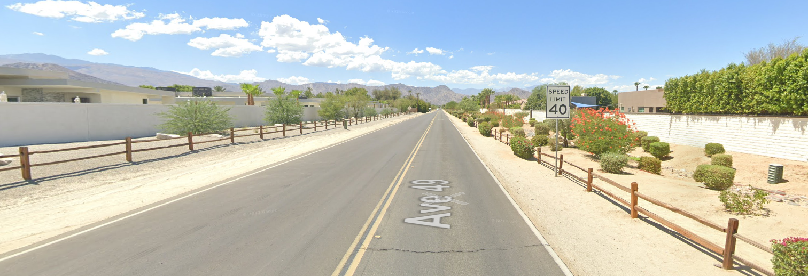
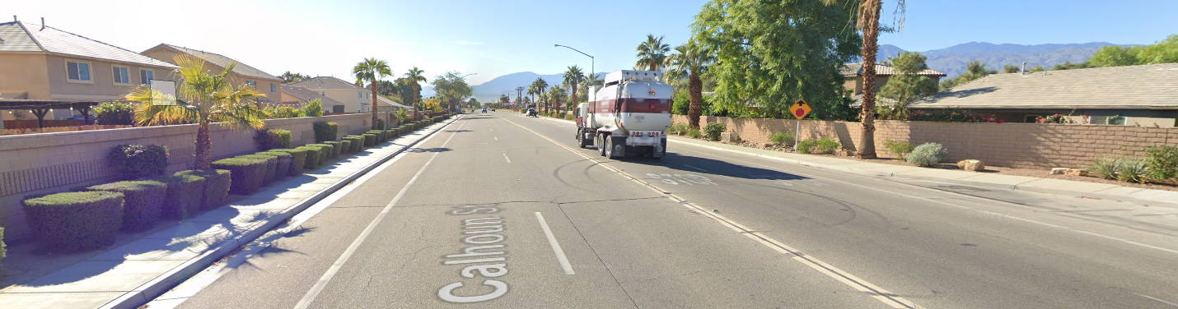

Slide 14
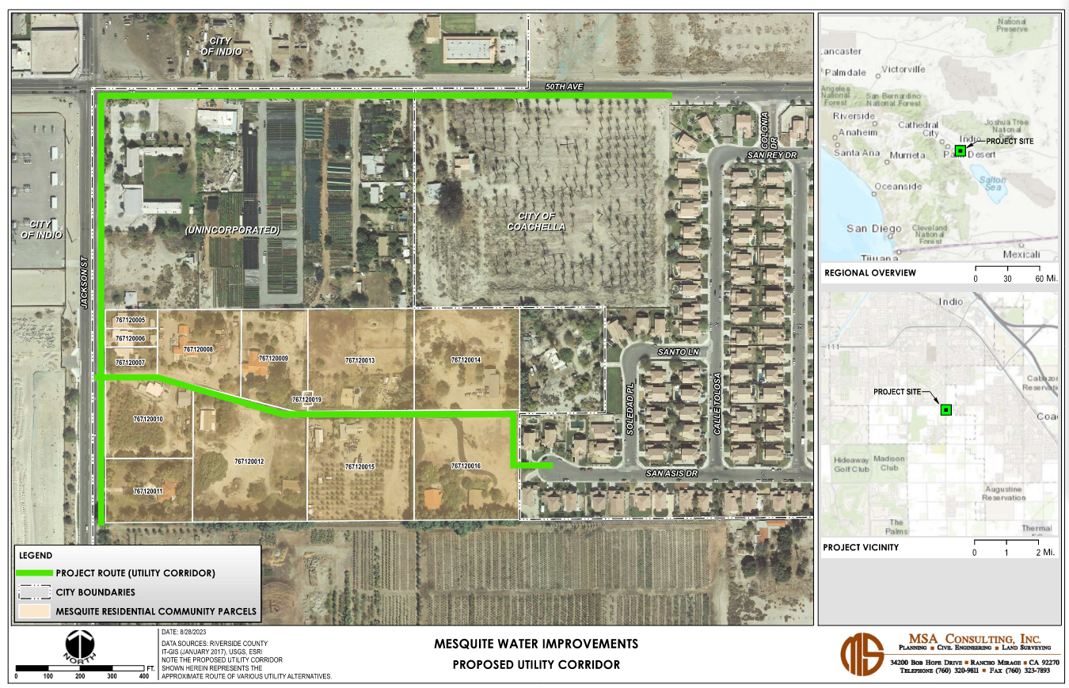

Slide 15
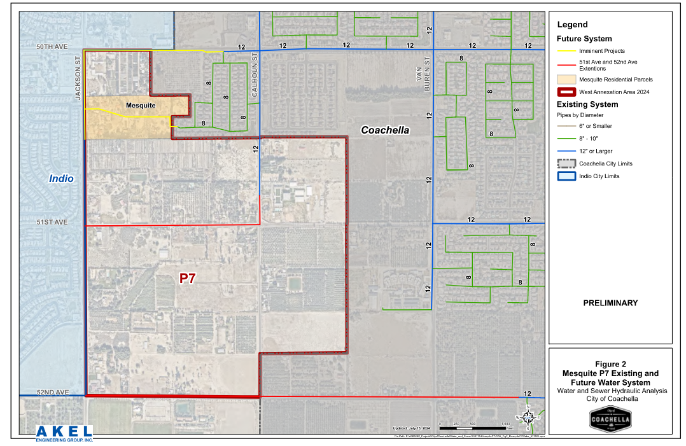
Water

Slide 16
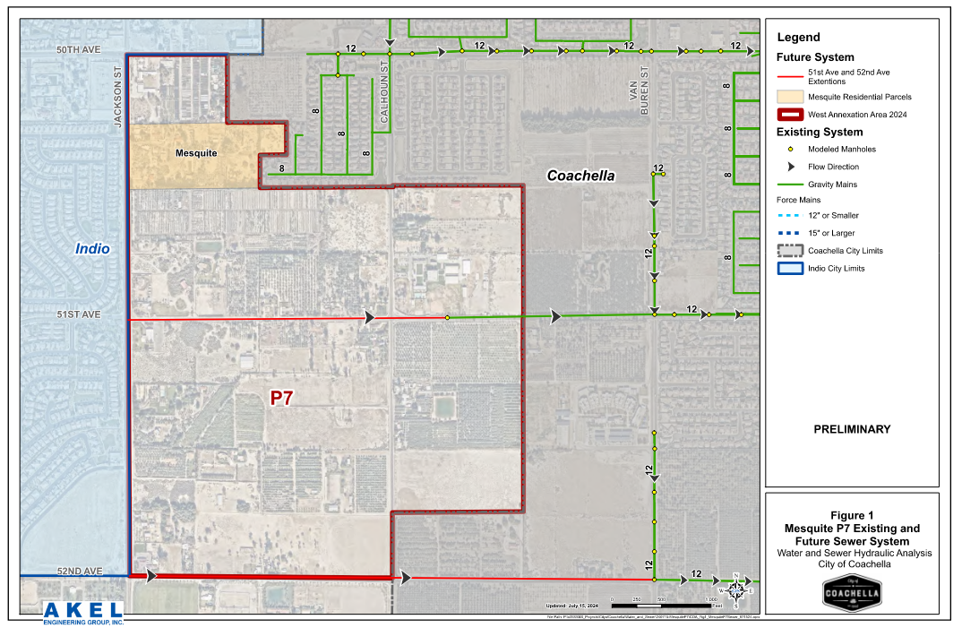
Sewer

Slide 17
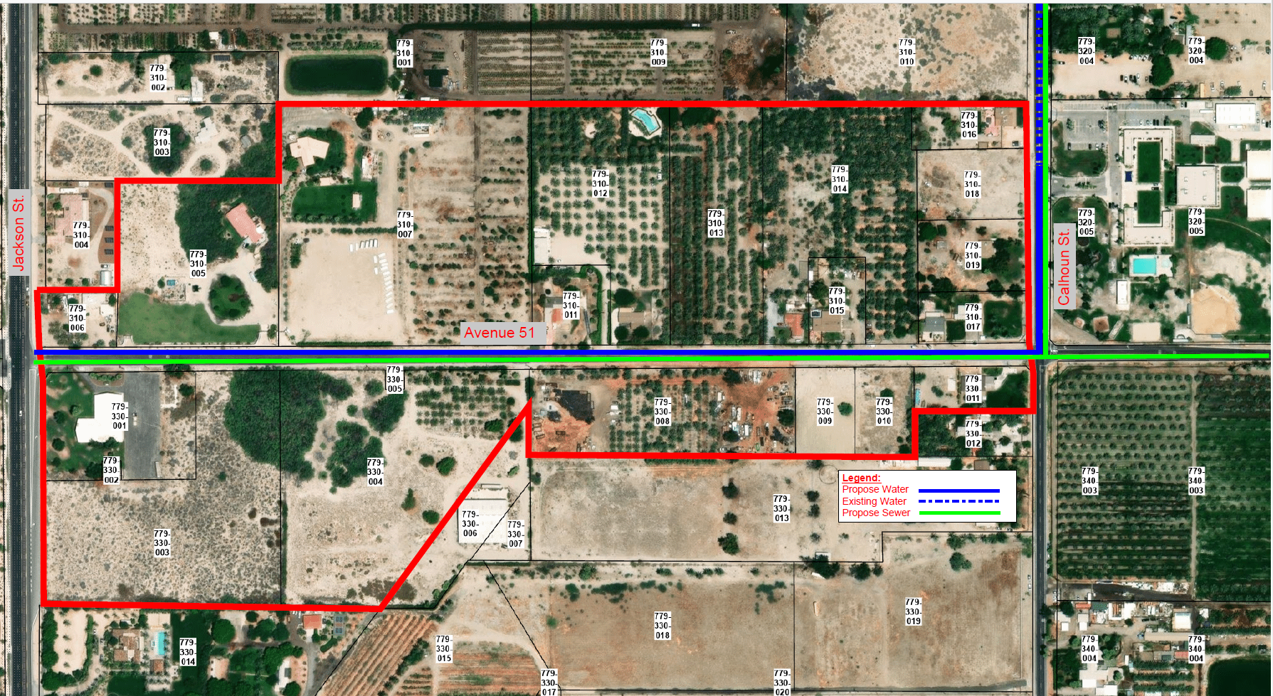
Water on Ave 51 between Jackson & Calhoun
Approximate cost: $1,400,000

Slide 18
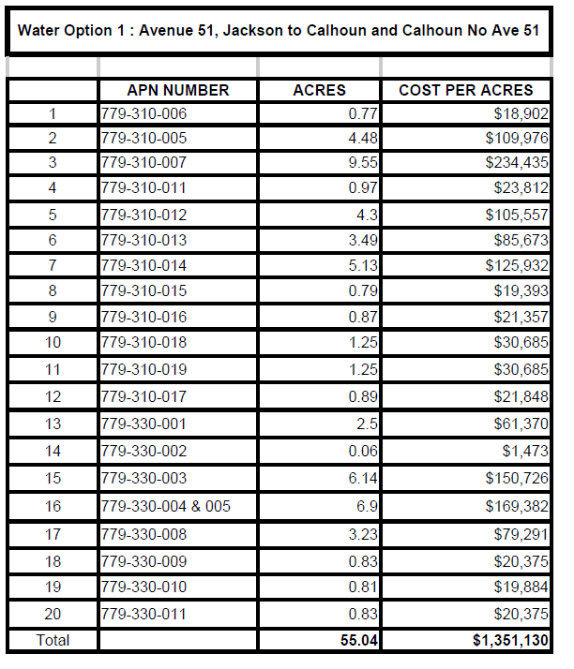
Potential Cost per Parcel

Slide 19
Sewer on Ave 51 between Jackson & Calhoun
Approximate cost: $2,400,000

Slide 20
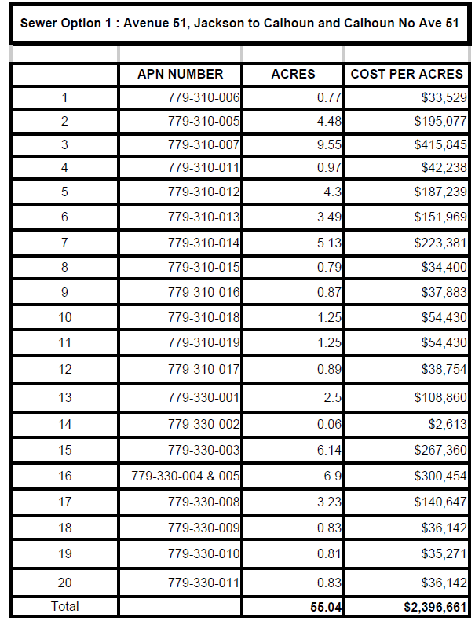
Potential Cost per Parcel

Slide 21
Annexation
Application: Council Resolution, Boundary Map, Plan of Services, Pre-Zoning and Fiscal Impact Analysis
LAFCO Steps: LAFCO Review, Commission Hearing
Protest Proceedings:
  LAFCO mails property owners and registered voters
  If <25% voter protest and <25% landowner protest – Annexation Proceeds
  If between 25-50% protest, or > 25% landowner protest then an elections held of voters
  If ≥ 50% voter protest – Annexation fails

Slide 22
Timeline
July 15, 2024 – Community Meeting - Library
October 1, 2024 – CEQA and fiscal analysis complete
October 16, 2024 – Planning Commission
November 13, 2024 – City Council
November 18, 2024 –LAFCO annexation submission Actual Date November 10
May 22, 2024 – Anticipated LAFCO hearing date

Slide 23
How Can You Help?
Sign Support Letter
Participate in May 22, 2025 meeting
Meet with staff about future plans

Slide 24
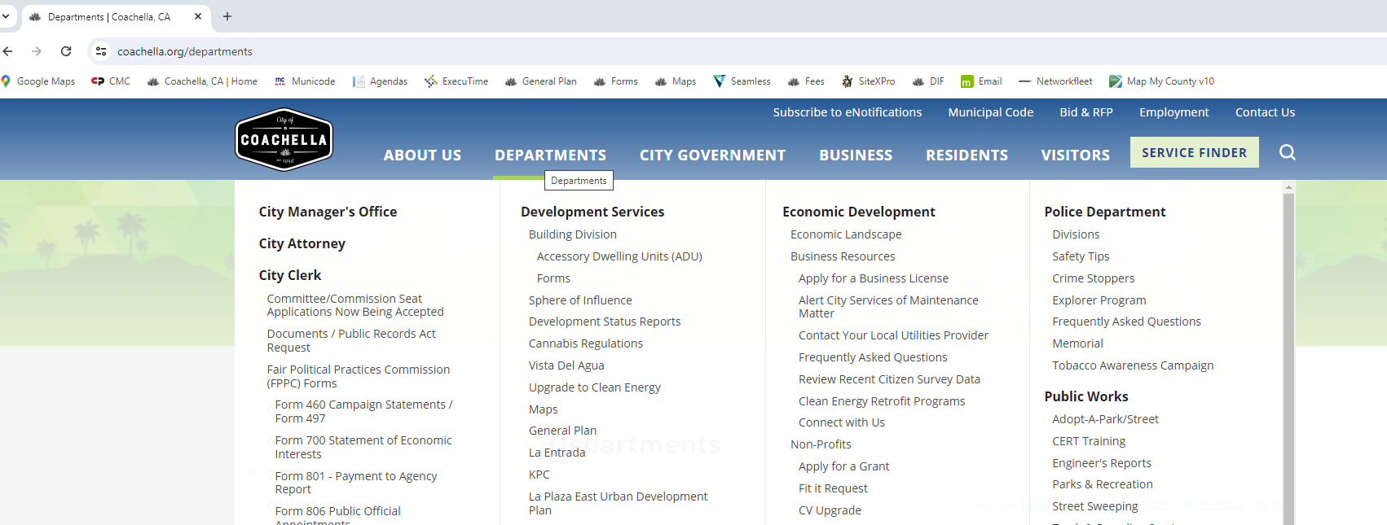

Slide 25
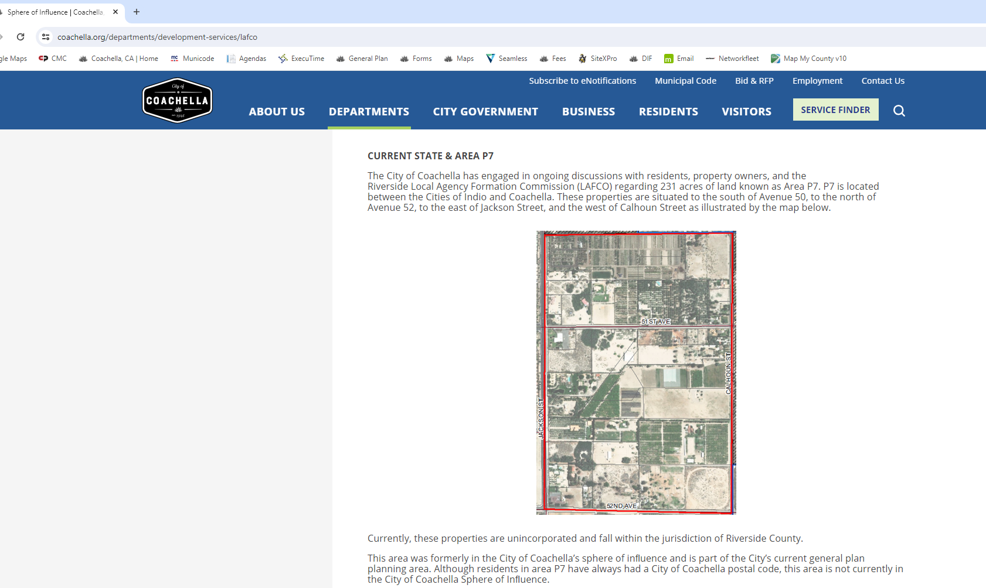

Slide 26
Questions/Comments

Slide 28
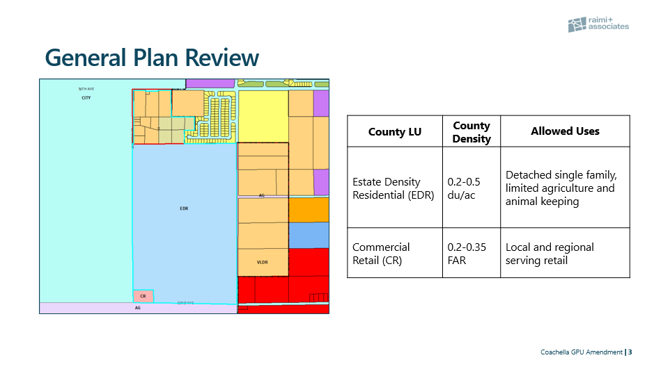

Slide 29
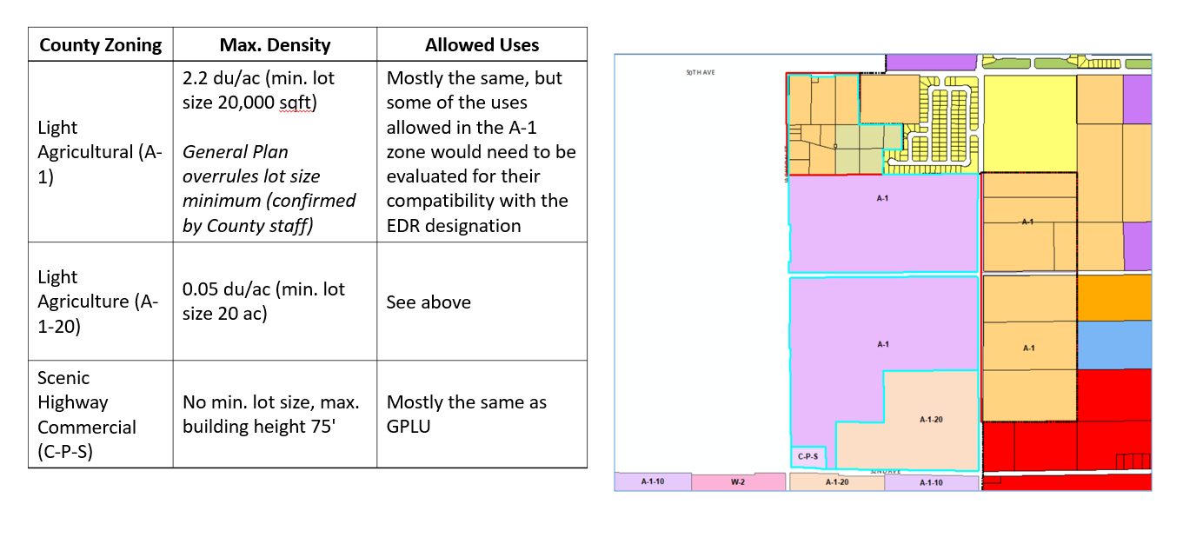
County Zoning

Slide 30
